Slide 1
Machine Learning
Lecture 19: Unsupervised Clustering (I): Hierarchical
Dr. Beilun Wang
Southeast University
School of Computer Science
and Engineering

Slide 2
Course Content Plan
Regression (supervised)
Classification (supervised)
Unsupervised models
Dimension Reduction (PCA)
Clustering (K-means, GMM/EM, Hierarchical )
Learning theory
Y is a continuous
Y is a discrete
NO Y
About f()
Graphical models
About interactions among X1,… Xp
Reinforcement Learning
Learn program to Interact with its environment

Slide 3
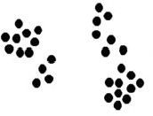
What is clustering?
Are there any “groups”?
What is each group?
How many?
How to identify them?

Slide 4



What is clustering?
Find groups (clusters) of data points such that data points in a group will be similar (or related) to one another and different from (or unrelated to) the data points in other groups
Inter-cluster
distances are maximized
Intra-cluster distances are minimized

Slide 5
What is clustering?
Clustering: the process of grouping a set of objects into classes of similar objects
high intra-class similarity
low inter-class similarity
It is the commonest form of unsupervised learning

Slide 6
What is clustering?
Clustering: the process of grouping a set of objects into classes of similar objects
high intra-class similarity
low inter-class similarity
It is the commonest form of unsupervised learning
A common and important task that finds many applications in Science, Engineering, information Science, and other places, e.g.
Group genes that perform the same function
Group individuals that has similar political view
Categorize documents of similar topics
Ideality similar objects from pictures

Slide 7
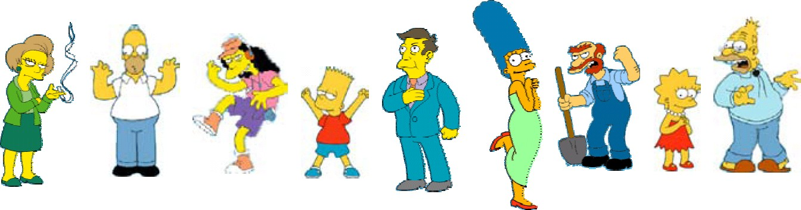
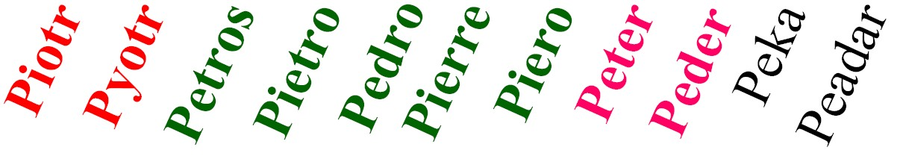
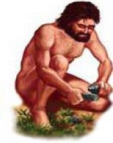
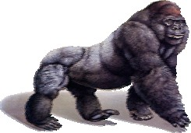
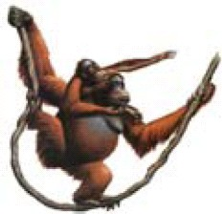
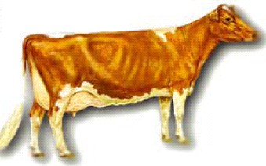
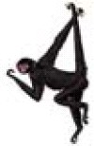
Toy Examples
People
Images
Language
species

Slide 8
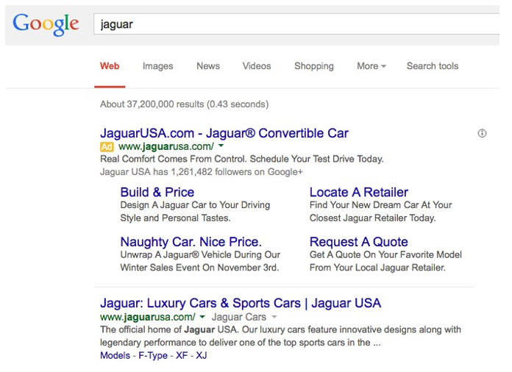
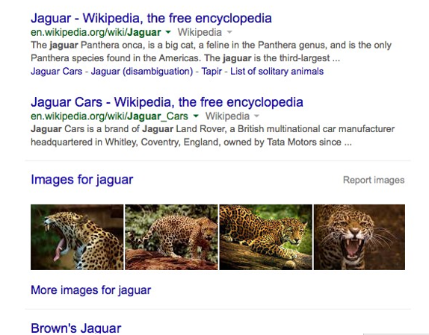
Application (I): Search Result Clustering

Slide 9
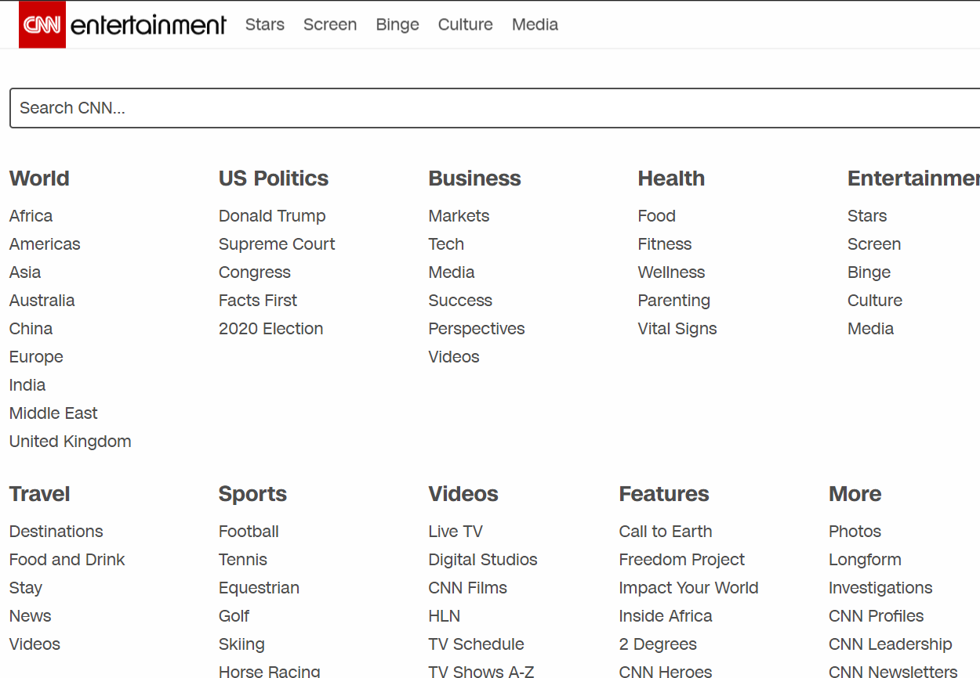
Application (II): Navigation
Hierachy

Slide 10
Issues for clustering
What is a natural grouping among these objects?
What makes objects “related”?
Representation for objects
How many clusters?
Clustering Algorithms
Formal foundation and convergence

Slide 11
Today
Definition of "groupness"
Definition of "similarity/distance“
Clustering Algorithms
Hierarchical algorithms
Partitional algorithms
Formal foundation and convergence
How many clusters?

Slide 12
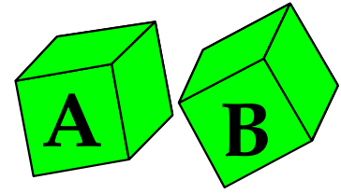
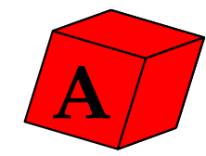
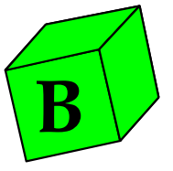
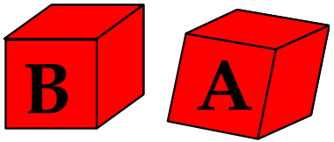
What is a natural grouping among them?
Two possible Solutions:
A
A
A
A
B
A
A
B
B
B
B
B

Slide 13
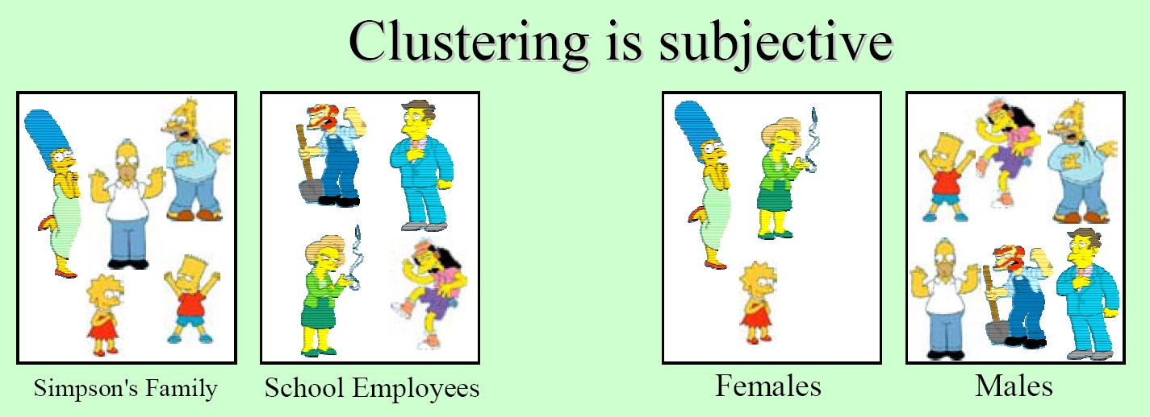
What is a natural grouping among them?

Slide 14
Today
Definition of "groupness"
Definition of "similarity/distance"
Clustering Algorithms
Hierarchical algorithms
Partitional algorithms
Formal foundation and convergence
How many clusters?

Slide 15
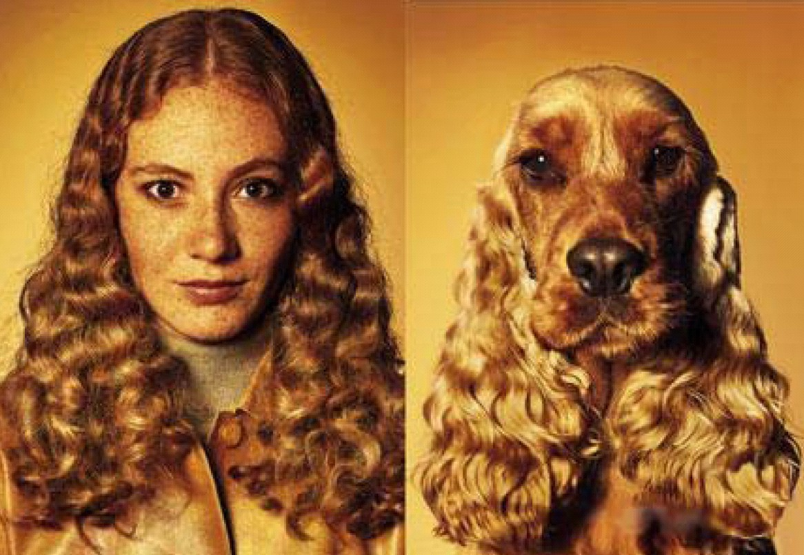
What is Similarity?
Hard to define. But we know it when we see it.
The real meaning of similarity is a philosophical question. We will take a more pragmatic approach.
Depends on representation and algorithm. For many rep./alg., easier to think in terms of a distance (rather than similarity) between vectors.

Slide 16
Properties of distance measure
D(A,B) = D(B,A) Symmetry
D(A,A) = 0
Constancy of Self-Similarity
D(A,B) = 0 IIf A= B
Positivity Separation
D(A,B) <= D(A,C) + D(B,C)
Triangular Inequality

Slide 17
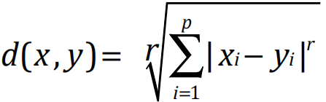
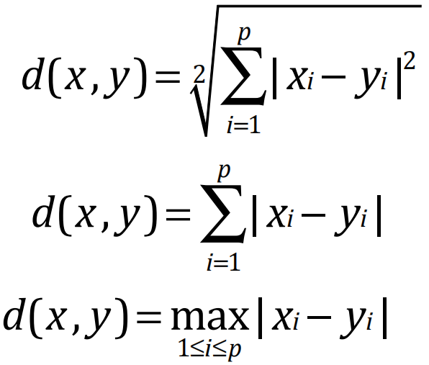
Distance Measures: Minkowski Metric
Suppose two object x and y both have p features
x = (x₁ , x₂ ,…, x_{p} )
y = ( y₁ , y₂ ,…, y_{p} )
The Minkowski metric is defined by
Most Common Minkowski Metrics
p
r = 2(Euclidean distance )
d(x , y) = ² ∑| xi − yi |²
i=1 p
r = 1(Manhattan distance)
r = +∞ ("sup" distance )
d(x , y) = ∑| xi − yi |
i=1
d(x , y) = max| xi − yi |
1≤i≤p

Slide 18
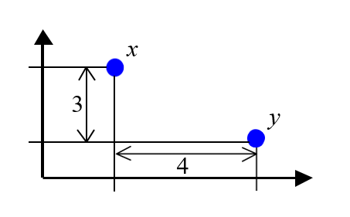
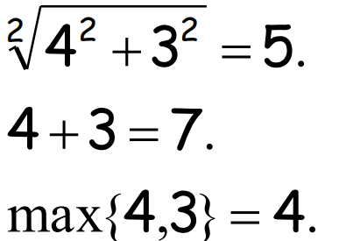
An Example
4
1. Euclidean distance:
2. Manhattan distance:
3. "sup" distance:

Slide 19
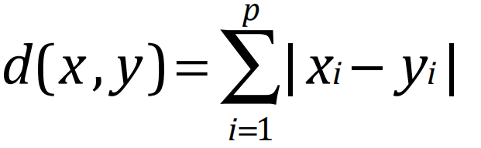
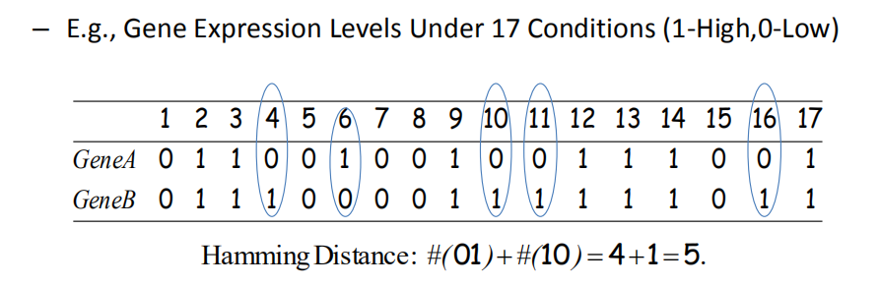
Hamming distance: discrete features
Manhattan distance is called Hamming distance
when all features are binary or discrete.

Slide 20
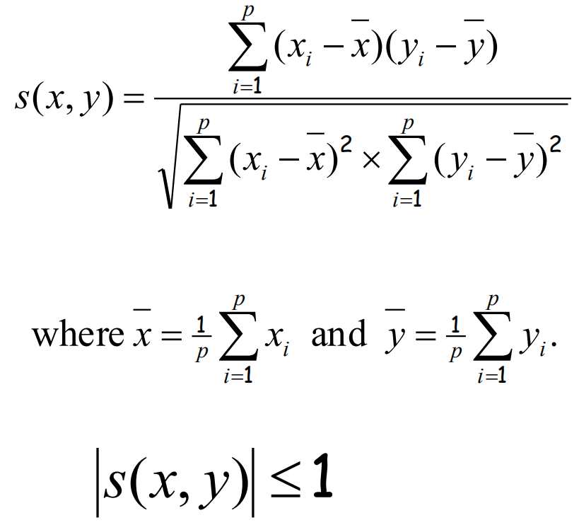
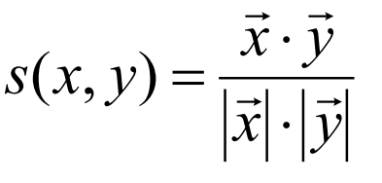
Similarity Measures: Correlation Coefficient
Pearson correlation coefficient
Measuring the linear correlation
between two sequences, x and y,
giving a value between +1 and −1 inclusive, where 1 is total positive correlation, 0 is no correlation, and
−1 is total negative correlation.
Correlation is unit independent
Special case: cosine distance

Slide 21
Today
Definition of "groupness"
Definition of "similarity/distance"
Clustering Algorithms
Hierarchical algorithms
Partitional algorithms
Formal foundation and convergence
How many clusters?

Slide 22
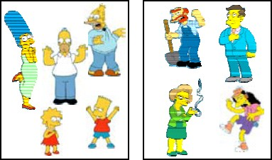
Clustering Algorithms
Partitional algorithms
Usually start with a random (partial) partitioning
Refine it iteratively
K means clustering
Mixture-Model based clustering
Hierarchical algorithms
Bottom-up, agglomerative
Top-down, divisive

Slide 23
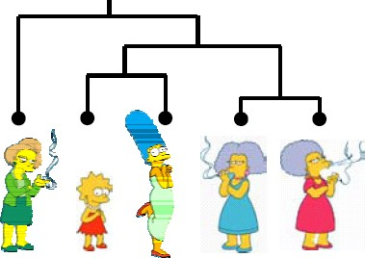
Clustering Algorithms
Partitional algorithms
Usually start with a random (partial) partitioning
Refine it iteratively
K means clustering
Mixture-Model based clustering
Hierarchical algorithms
Bottom-up, agglomerative
Top-down, divisive

Slide 24
Today
Definition of "groupness"
Definition of "similarity/distance"
Clustering Algorithms
Hierarchical algorithms
Partitional algorithms
Formal foundation and convergence
How many clusters?

Slide 25
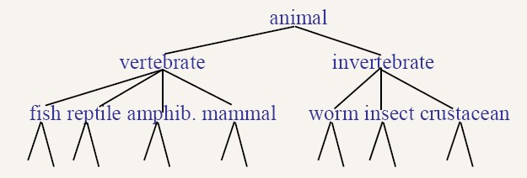
Hierarchical Clustering
Build a tree-based hierarchical taxonomy (dendrogram) from a set of objects, e.g. organisms, documents.
With backbone
Without backbone
Note that hierarchies are commonly used to organize information, for example in a web portal.

Slide 26
Hierarchical Clustering
Given: a set of objects and the pairwise distance matrix
Find: a tree that optimally hierarchical clustering objects
Globally optimal: exhaustively enumerate all tree
Effective heuristic methods

Slide 27
Hierarchical Clustering
Task Representation Score Function |  | Clustering Choice of distance metrics No clearly defined loss
Search/Optimization Models, Parameters |  | greedy bottom-up (or top-down) Dendrogram (tree)

Slide 28
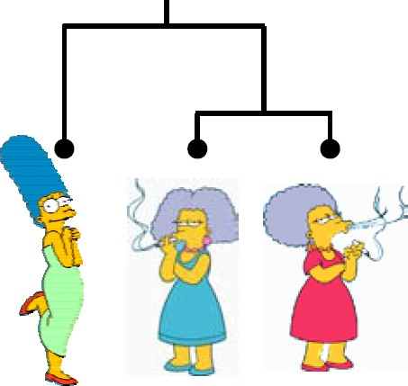
Distance: A technique for measuring similarity
To measure the similarity between two objects, transform one of the objects into the other, and measure how much effort it took. The measure of effort becomes the distance measure.
The distance between Patty and Selma.
Change dress color, 1 point Change earring shape, 1 point Change hair part, 1 point
D(Patty,Selma) = 3
The distance between Marge and Selma.
Change dress color, 1 point Add earrings, 1 point Decrease height, 1 point Take up smoking, 1 point Lose weight, 1 point
D(Marge,Selma) = 5
Marge Patty Selma
This is called the Edit distance or the Transformation distance

Slide 29

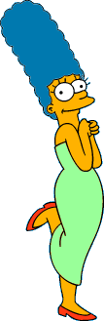




Hierarchical Clustering
The number of dendrograms with n leafs
Bottom-Up (agglomerative): Starting with each item in its own cluster, find the best pair to merge into a new cluster. Repeat until all clusters are fused together.
= (2n -3)!/[(2^{(n -2)}) (n -2)!]
Number of Leafs 2
3
4
5
... 10
Number of Possible Dendrograms
1
3
15
105
… 34,459,425
np
A greedy local optimal solution
Clustering: the process of grouping a set of objects into classes of similar objects ➔
high intra-class similarity low inter-class similarity

Slide 30


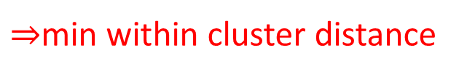
Hierarchical Clustering
We begin with a distance matrix which contains the distances between every pair of objects in our database.
0 | 8 | 8 | 7 | 7
 | 0 | 2 | 4 | 4
 |  | 0 | 3 | 3
 |  |  | 0 | 1
 |  |  |  | 0
$⇒$min within cluster distance
D( , ) = 8
D( , ) = 1

Slide 31

Bottom-Up (agglomerative): Starting with each item in its own cluster, find the best pair to merge into a new cluster. Repeat until all clusters are fused together.
Consider all
Possible merges
…
Choose
the best

Slide 32

Bottom-Up (agglomerative): Starting with each item in its own cluster, find the best pair to merge into a new cluster. Repeat until all clusters are fused together.
Consider all possible merges…
Choose the best
…
Consider all
Possible merges
…
Choose
the best
2020/2
Beilun Wang
32

Slide 33
Bottom-Up (agglomerative): Starting with each item in its own cluster, find the best pair to merge into a new cluster. Repeat until all clusters are fused together.
Consider all possible merges…
Choose the best
…
Consider all possible merges…
Choose the best
…
Consider all
Possible merges
…
Choose
the best
2020/2
2020/2
Beilun Wang
Beilun Wang
33
33

Slide 34
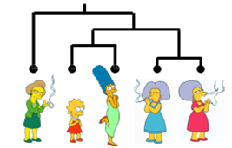
Bottom-Up (agglomerative): Starting with each item in its own cluster, find the best pair to merge into a new cluster. Repeat until all clusters are fused together.
Consider all possible merges…
Choose the best
But how do we compute distances between clusters rather than objects?
…
Consider all possible merges…
Choose the best
…
Consider all
Possible merges
…
Choose
the best
2020/2
2020/2
Beilun Wang
Beilun Wang
34
34

Slide 35
How to decide the distances between clusters?
Single-Link
Nearest Neighbor: their closest members.
Complete-Link
Furthest Neighbor: their furthest members.
Average:
average of all cross-cluster pairs.

Slide 36



Single Link
cluster distance = distance of two closest members in each class
$$C_{1}$$
Potentially long and skinny clusters
$$C_{3}$$
$$C_{2}$$

Slide 37




Complete Link
cluster distance = distance of two farthest members
$$C_{1}$$
$$C_{3}$$
tight clusters
$$C_{2}$$

Slide 38
Average Link
cluster distance = average distance of all pairs
the most widely used measure
Robust against noise

Slide 39
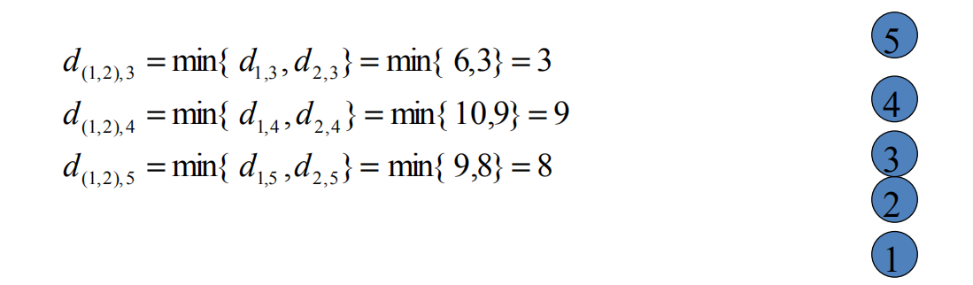
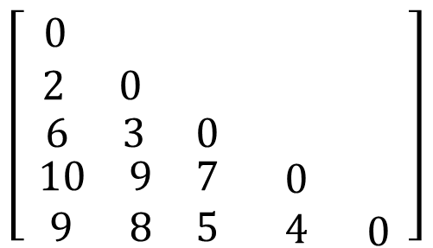
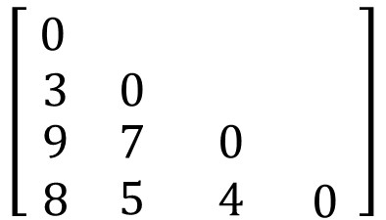
Example: single link
1 2 3 4 5
(1,2) 3 4 5
1
2
3
4
5
$$\left[\begin{matrix}\begin{matrix}\begin{matrix} 0 & \end{matrix} & \end{matrix} & & \\ \begin{matrix}\begin{matrix} 2 & 0\end{matrix} & \end{matrix} & & \\ \begin{matrix}\begin{matrix}\begin{matrix}6 & 3\end{matrix} \\ \begin{matrix}\begin{matrix}10 \\ 9\end{matrix} & \begin{matrix}9 \\ 8\end{matrix}\end{matrix}\end{matrix} & \begin{matrix}0 \\ \begin{matrix}7 \\ 5\end{matrix}\end{matrix}\end{matrix} & \begin{matrix} \\ \begin{matrix}0 \\ 4\end{matrix}\end{matrix} & \begin{matrix} \\ \begin{matrix} \\ 0\end{matrix}\end{matrix}\end{matrix} \right]$$
(1,2)
3
4
5
$$\left[\begin{matrix}\begin{matrix} 0 & \end{matrix} & & \\ \begin{matrix}3 & 0\end{matrix} & & \\ \begin{matrix}\begin{matrix}9 \\ 8\end{matrix} & \begin{matrix}7 \\ 5\end{matrix}\end{matrix} & \begin{matrix}0 \\ 4\end{matrix} & \begin{matrix} \\ 0\end{matrix}\end{matrix} \right]$$

Slide 40

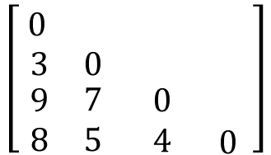
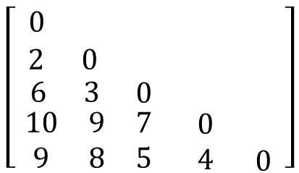
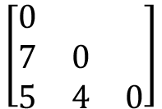
Example: single link
1 2 3 4 5
(1,2) 3 4 5
(1,2,3) 4 5
1
2
3
4
5
$$\left[\begin{matrix}\begin{matrix}\begin{matrix} 0 & \end{matrix} & \end{matrix} & & \\ \begin{matrix}\begin{matrix} 2 & 0\end{matrix} & \end{matrix} & & \\ \begin{matrix}\begin{matrix}\begin{matrix}6 & 3\end{matrix} \\ \begin{matrix}\begin{matrix}10 \\ 9\end{matrix} & \begin{matrix}9 \\ 8\end{matrix}\end{matrix}\end{matrix} & \begin{matrix}0 \\ \begin{matrix}7 \\ 5\end{matrix}\end{matrix}\end{matrix} & \begin{matrix} \\ \begin{matrix}0 \\ 4\end{matrix}\end{matrix} & \begin{matrix} \\ \begin{matrix} \\ 0\end{matrix}\end{matrix}\end{matrix} \right]$$
(1,2,3)
4
5
$$\left[\begin{matrix}0 & & \\ 7 & 0 & \\ 5 & 4 & 0\end{matrix}\right]$$
(1,2)
3
4
5
$$\left[\begin{matrix}\begin{matrix} 0 & \end{matrix} & & \\ \begin{matrix}3 & 0\end{matrix} & & \\ \begin{matrix}\begin{matrix}9 \\ 8\end{matrix} & \begin{matrix}7 \\ 5\end{matrix}\end{matrix} & \begin{matrix}0 \\ 4\end{matrix} & \begin{matrix} \\ 0\end{matrix}\end{matrix} \right]$$
5
4
3
2
1
4
3
2

Slide 41
Example: single link
1 2 3 4 5
(1,2) 3 4 5
(1,2,3) 4 5
1
2
3
4
5
$$\left[\begin{matrix}\begin{matrix}\begin{matrix} 0 & \end{matrix} & \end{matrix} & & \\ \begin{matrix}\begin{matrix} 2 & 0\end{matrix} & \end{matrix} & & \\ \begin{matrix}\begin{matrix}\begin{matrix}6 & 3\end{matrix} \\ \begin{matrix}\begin{matrix}10 \\ 9\end{matrix} & \begin{matrix}9 \\ 8\end{matrix}\end{matrix}\end{matrix} & \begin{matrix}0 \\ \begin{matrix}7 \\ 5\end{matrix}\end{matrix}\end{matrix} & \begin{matrix} \\ \begin{matrix}0 \\ 4\end{matrix}\end{matrix} & \begin{matrix} \\ \begin{matrix} \\ 0\end{matrix}\end{matrix}\end{matrix} \right]$$
(1,2,3)
4
5
$$\left[\begin{matrix}0 & & \\ 7 & 0 & \\ 5 & 4 & 0\end{matrix}\right]$$
(1,2)
3
4
5
$$\left[\begin{matrix}\begin{matrix} 0 & \end{matrix} & & \\ \begin{matrix}3 & 0\end{matrix} & & \\ \begin{matrix}\begin{matrix}9 \\ 8\end{matrix} & \begin{matrix}7 \\ 5\end{matrix}\end{matrix} & \begin{matrix}0 \\ 4\end{matrix} & \begin{matrix} \\ 0\end{matrix}\end{matrix} \right]$$
5
4
3
2
1
4
5
3
2

Slide 42
Single link & Average link
7
6
5
4
3
2
1
29 2 6 11 9 17 10 13 24 25 26 20 22 30 27 1 3 8 4 12 5 14 23 15 16 18 19 21 28 7
Single linkage
Average linkage

Slide 43
Hierarchical Clustering
Bottom-Up Agglomerative Clustering
Starts with each object in a separate cluster
repeatedly joins the closest pair of clusters
Until there is only one cluster
Top-Down divisive
Start with all the data in a single cluster
Consider every possible way to divide the cluster into two. Choose the best division.
Recursively operate on both sides

Slide 44

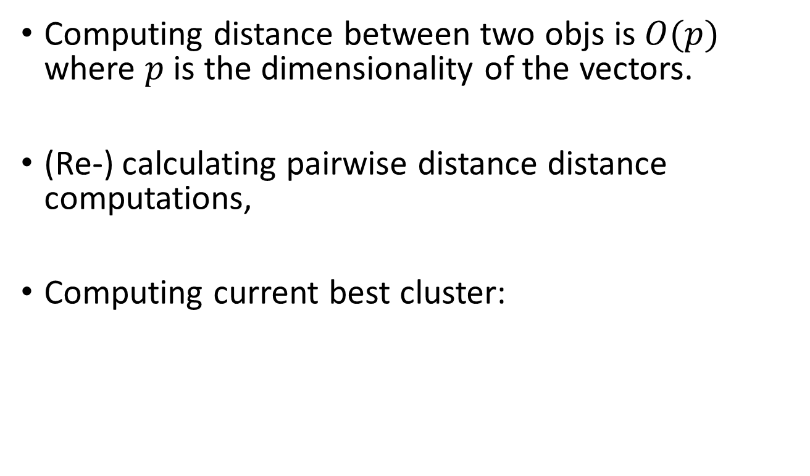


Time Complexity
Computing distance between two objs is $O(p)$ where $p$ is the dimensionality of the vectors.
(Re-) calculating pairwise distance distance computations,
Computing current best cluster:
$$O(n^{2}p)$$
$$O(n^{2})$$
A total of n−1 merging iterations
$$O(n^{3}p)$$

Slide 45
Summary of Hierarchal Clustering
No need to specify the number of clusters in advance.
Hierarchical structure maps nicely onto human intuition for some domains.
They do not scale well: time complexity of at least O(n²), where n is the number of total objects.
Like any heuristic search algorithms, local optima is a problem.
Interpretation of results is (very) subjective.

Slide 46
Recap: Hierarchical Clustering
Task Representation Score Function |  | Clustering Choice of distance metrics No clearly defined loss
Search/Optimization Models, Parameters |  | greedy bottom-up (or top-down) Dendrogram (tree)

Slide 47
References
https://qiyanjun.github.io/2019f-UVA-CS6316-MachineLearning/
Hastie, Trevor, et al. The elements of statistical learning. Vol. 2. No. 1. New York: Springer, 2009.
Big thanks to Prof. Eric Xing @ CMU for allowing me to reuse some of his slides
Big thanks to Prof. Ziv Bar-Joseph @ CMU for allowing me to reuse some of his slides

Slide 48
Thanks for listening

